Slide 1
Safeguarding
Awareness
By Helen Evans

Slide 2
Content:
Introduction
Manual – keys points
Safeguarding process
Who to contact inc. out of hours
Discussion and consent form
Code of conduct - staff
Code of conduct - volunteers

Slide 3
Introduction
Safeguarding is about preventing harm and abuse occurring through providing high quality effective care. It is also about our patients’ experience of care provided and how well they are supported should they be harmed or abused.

Slide 4
Safeguarding policies
Can you name the safeguarding policies at HXH?
Which cross reference polices might be used when referring to safeguarding?
SSAB – Surrey Safeguarding Adults Board policy and procedure 2018
Protecting and safeguarding adults at risk
Safeguarding children
Consent
Restraint
Code of conduct – all staff
Code of conduct – visitors
Cross reference policies:
  Accounting for patients money
  Anti-harassment and victimisation
  Complaint
  Consent
  Disciplinary
  Equal opportunities and diversity
  Grievance procedure
  Notification of events
  Public disclosure
  Recruitment
  Recruitment of sex offenders
  Restraint
  Risk management
  Visiting

Slide 5
Protecting and safeguarding adults at risk policy
Holy Cross Hospital is strongly committed to defining and implementing practices that protect adults at risk, whether patients or visitors, from abuse, neglect or significant harm or distress.
An adult at risk is defined as a person over the age of 18 years:
  who is in need or may be in need of care services by reason of mental or other disability, age or illness
  who is unable to take care of him or herself or unable to protect him or herself against significant harm or exploitation.
Adults at risk may be victims or perpetrators, or both of abuse

Slide 6
Protecting and safeguarding adults at risk policy continued
What types of abuse are there?
Can you identify the safeguarding officers?
Types of abuse
  Physical
  Sexual
  Psychological
  Financial or material
  Neglect or act of omission
  Discriminatory
  Self neglect
  Domestic violence or abuse
  Modern slavery
  Organisational or institutional abuse
Accountability and responsibility
  Safeguarding officers:
    CEO
    DNS
    Night sister
Confidentiality
Recording
Staff support and training
Disclosure and Baring Service
Assessment and intervention

Slide 7
Protecting and safeguarding adults at risk policy continued
Procedure to be followed if abuse is suspected
  Listen, observe, record and report
  Ensure the adult at risk is safe and receiving appropriate care
  Preserve evidence
Filing safeguarding incidents
  Summary kept in the compliments and complaints register
Risk assessment
  A patients own visitor
  Other patient visitors
  Potential patients relatives visiting prior to admission
  Staff
  Student nurses
  External carers
  Volunteers
  Contractors
  People hiring the pool or other facilities
  Sales reps
  Out patients and those accompanying them
  CCG or social services representatives
  Visiting priests or sisters

Slide 8
Safeguarding children policy
Procedure to be followed if abuse is suspected
  Disclosure of abuse by a child should always be taken seriously
  Listen carefully, make observations, document the facts
  Reassure the child they are being taken seriously and disclosure will be reported to the safeguarding officer
  Do not question the child
  Inform NIC immediately. NIC will inform the senior nurse on duty without delay. Senior nurse will inform the safeguarding officer

Slide 9
Consent policy
Valid consent is essential to all forms of healthcare delivery from the provision of personal care and non-invasive procedures to invasive interventions including surgery.
It is the duty of health professionals undertaking procedures to be confident that the person consents or they are acting in the best interests of the person and therefore proceeding on a lawful basis

Slide 10
Consent policy continued
Validity:
For consent to be valid the person must:
  Understand information relevant to the decision
  Retain the information
  Weigh up information about different options
  Have received sufficient information regarding the procedure
  Not be acting under duress
  Communicate the decision
Capacity
Capacity
  is ‘decision-specific’ concentrating on the matter related to the decision rather than the ability to make decisions generally.
  Capacity is ‘time specific’ focusing on the time the decision is to be made

Slide 11
Consent policy continued
Decisions regarding capacity should be guided by the five core principles included in the Mental Capacity Act 2005:
  Principle 1 - A person must be assumed to have capacity unless he/she have been proven to lack capacity
  Principle 2 – A person is not to be treated as unable to make a decision unless all practicable steps to help him/her do so have been taken
  Principle 3 – A person is not to be treated as unable to make a decision merely because he/she makes an unwise decision
  Principle 4 – An act done or decision made under this Act for or on behalf of a person who lacks capacity must be done or made in his/her best interests
  Principle 5 – Before the act is done or the decision made, regard must be given to whether the purpose for which it is needed can be as effectively achieved in a way that is less restrictive of the person’s rights and freedom of action

Slide 12
Consent policy continued
Best interests
One of the key principles of the Mental Capacity Act 2005 is that any decision made on a person’s behalf is in their best interests.
The Act requires steps to be followed to determine what is in someone’s best interests
When to seek consent
Provision of information
Documentation
Responsibility for seeking consent
Refusal of treatment
Second opinions and court proceedings
Clinical photography and video recordings

Slide 13
Restraint policy
The application of restraint at Holy Cross Hospital is used as a last resort for the sole purpose of ensuring the safety and wellbeing of a patient.
When deciding to use restraint the clinical team must assess why restraint is necessary and monitor its use carefully.
Restraint should only be used when other methods of therapeutic behaviour management have been unsuccessful.
The decision to use restraint must be discussed with the patient (if competent) and their close family, fully documented and reviewed regularly
Every person (not subject to legal detention) has the right to be free from restrictions to his or her speech or movement. Restraint therefore could be described as a breach of a person’s fundamental human rights, although there may be circumstances where other considerations override this

Slide 14
Restraint policy Continued
There is no legal definition of the term ‘restraint’.
It can be described as ‘an intervention that prevents a person from behaving in ways that threaten or cause harm to themselves, others or property’ (Duff et al 1996).
A further description is ‘any device, material or equipment attached to or near a person’s body and which cannot be controlled or easily removed by the person and which deliberately prevents or is deliberately intended to prevent a person’s free body movement to a position of choice and/or a person’s access to their body’

Slide 15
Restraint policy continued
METHODS OF RESTRAINT
  Restraint can be overt and deliberate or discreet or even accidental. Everyday equipment and routine practices could in some circumstances be regarded as restraint therefore understanding the motives behind the restraint is critical.
Methods of restraint may include:
  Bed rails
  Hammocks or cocoon beds
  Bed height that is too high or too low
  Inappropriate use of wheelchair safety straps (lap or head)
  Reclining chairs or other chairs where the construction immobilises the patient
  Arrangement of furniture which prevents movement
  Use of beanbags for seating
  Harnesses
  Locked doors
  Coded locks
  Stair gates
  Removal of sensory aids e.g. spectacles
  Removal of outdoor shoes and/or walking aids
  Physical holds
  Inappropriate use of sheets etc.
  Inappropriate use of night clothes during the day
  Isolation
  Electronic tagging
  Medication
  Camera surveillance
Can you name some methods of restraint?

Slide 16
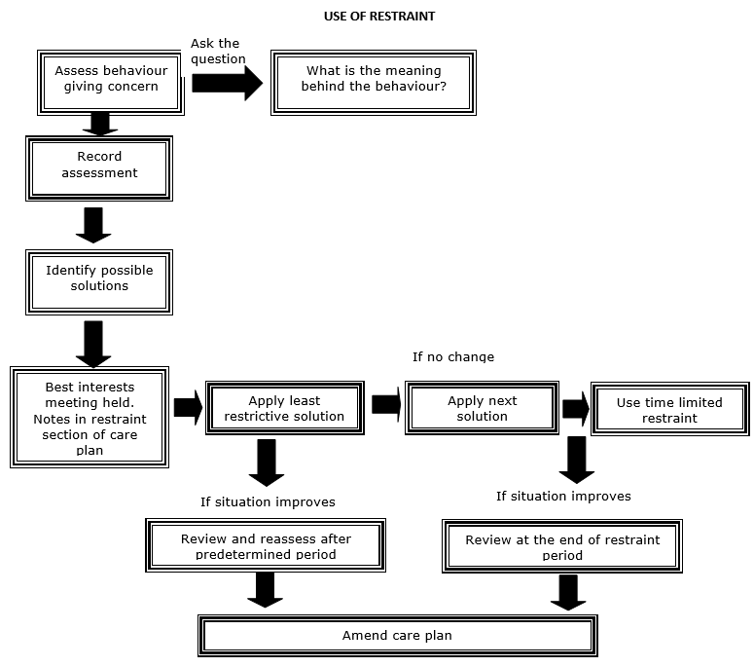

Slide 17
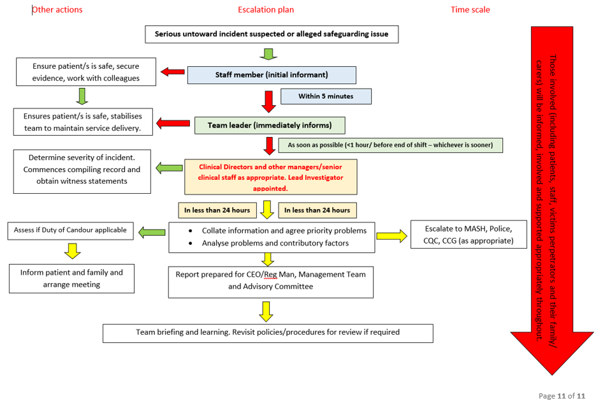
Safeguarding process – what to do and what happens
What should you do if you see or suspect abuse?
Who would you inform?
Who would you contact out of hours?
What would you do in an emergency?
What is M.A.S.H?

Slide 18
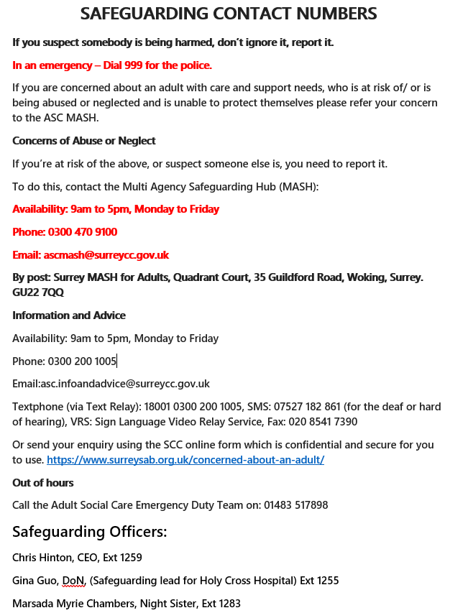
Who to contact
Where might you find information on who to contact?
Can you remember who the safeguarding officers are?

Slide 19
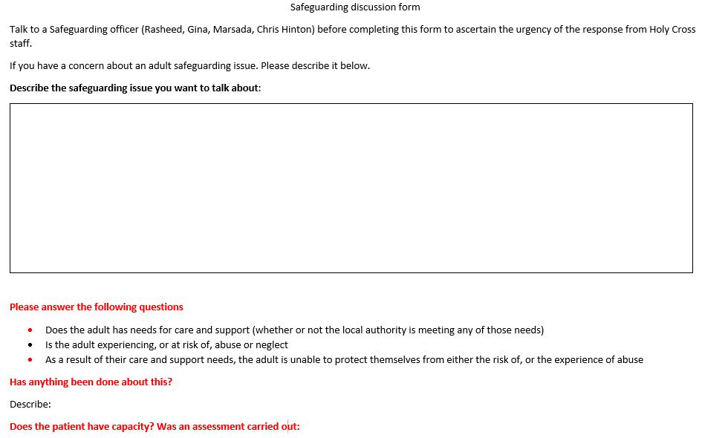
Safeguarding discussion form

Slide 20
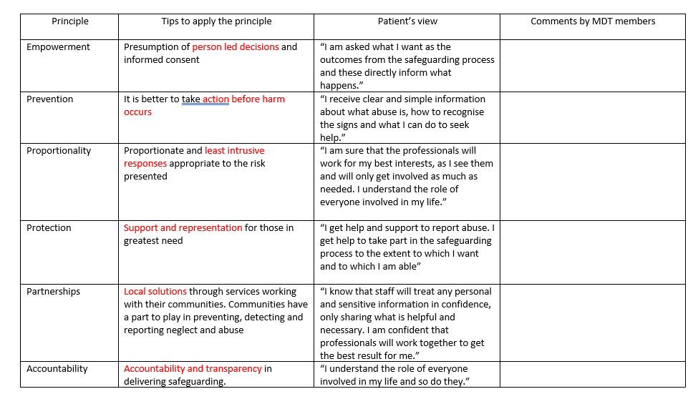
Safeguarding discussion form continued

Slide 21
Safeguarding Code of Conduct – All Staff
This code sets out standards of behaviour expected from staff when dealing with vulnerable adults and/or children.
  Although children are not treated at Holy Cross Hospital they are allowed to visit so it is important to ensure they are safe and feel comfortable during the time they are on the premises
  A vulnerable adult may be a patient or a visitor

Slide 22
Safeguarding Code of Conduct – All Staff Continued
Staff must:
  Respect patients’ right to privacy
  Encourage vulnerable adults and/or visiting children to report attitudes or behaviour they do not like
  Make sure communication with vulnerable adults and children is clear and not open to misinterpretation
  Act with discretion with regards to personal relationships and ensure personal relationships do not affect their role in the hospital
  Declare any pre-existing relationships with a vulnerable adult, visiting child or family member
  Inform their line manager if they find themselves the subject of inappropriate affection or attention from a vulnerable adult, a family member or a visiting child
  Be aware of procedures for reporting concerns or incidents relating the welfare of a vulnerable adult or visiting child including concerns about the actions or behaviour of another member of staff or concerns based on a conversation with a patient or visiting child
  Participate in safeguarding training every year at level 1 for all staff, and clinical staff level 1 and level 2 yearly, with enhanced safeguarding for clinical professionals every 2 years or as instructed by the Safeguarding lead
  Visiting policy
  Public interests disclosure (Whistle blowing) policy
  Learning and development plan
Staff must not:
  Spend excessive amounts of time alone with vulnerable adults or visiting children away from others
  Make any unnecessary physical contact with vulnerable adults or visiting children (it is recognised that physical contact with patients is a necessary part of the work of caring for them)
  Do things of a personal nature to a vulnerable adult or visiting child if they can do it themselves
  Initiate or engage in conversations or activities that could be interpreted as sexually provocative
  Use or allow the use of inappropriate language to go unchallenged
  Show favouritism to any one vulnerable adult or visiting child
  Threaten any form of punishment
  Meet vulnerable adults outside of the workplace
  Trivialise or exaggerate any potential vulnerable adult or child abuse issues
  Allow any allegations made by a vulnerable adult or visiting child to go without being reported and addressed
  Make promises to keep any disclosures confidential to relevant authorities
  Start an investigation or question anyone after an allegation or concern has been raised. The facts should be recorded and reported to the Safeguarding Officer

Slide 23
Safeguarding Code of Conduct - Volunteers
This code sets out standards of behaviour expected from volunteers when dealing with vulnerable adults and/or children
  Although children are not treated at Holy Cross Hospital they are allowed to visit so it is important to ensure they are safe during the time they or on the premises
  A vulnerable adult may be a patient or a visitor

Slide 24
Safeguarding Code of Conduct - Volunteers
Volunteers must:
  Respect patients’ right to privacy
  Encourage vulnerable adults and/or visiting children to report attitudes or behaviour they do not like
  Act with discretion with regards to personal relationships and ensure personal relationships do not affect their role in the hospital
  Declare any pre-existing relationships with a vulnerable adult or family member
  Inform the Social Activities Co-ordinator or Director of Clinical Services if they find they are the subject of inappropriate affection or attention from a vulnerable adult, a family member or a visiting child
  Be aware of procedures for reporting concerns or incidents relating the welfare of a vulnerable adult or visiting child including concerns about the actions or behaviour of another member of staff or concerns based on a conversation with a patient or visiting child
  Participate in safeguarding training every 3 years Visiting policy
  Public interests disclosure (Whistle blowing) policy
Volunteers must not:
  Spend excessive amounts of time alone with vulnerable adults or visiting children away from others
  Make any unnecessary physical contact with vulnerable adults or visiting children
  Do things of a personal nature to a vulnerable adult or visiting child if they can do it themselves
  Initiate or engage in conversations or activities that could be interpreted as sexually provocative
  Use or allow the use of inappropriate language to go unchallenged
  Show favouritism to any one vulnerable adult or visiting child
  Threaten any form of punishment
  Meet vulnerable adults outside of the workplace
  Trivialise or exaggerate any potential vulnerable adult or child abuse issues
  Allow any allegations made by a vulnerable adult or visiting child to go without being reported and addressed
  Make promises to keep any disclosures confidential to relevant authorities
  Start an investigation or question anyone after an allegation or concern has been raised. The facts should be recorded and reported to the Social Activities Co-ordinator or Director of Clinical Services

Slide 25
Thank you for Listening
Any questions?

